Slide 1
NYC Motor Vehicle Collision Transparency
By: Gabriel Fernandez, Jason Jiang
Notes:
A recent congestion pricing plan will charge drivers $23 to enter Manhattan if implemented. It was part of NYC’s strategy to tackle congestion and other problems relating to the city’s health. This sparked our group’s interest in taking a look into the traffic congestion statistics in NYC - specifically relating to traffic accidents.

Slide 2
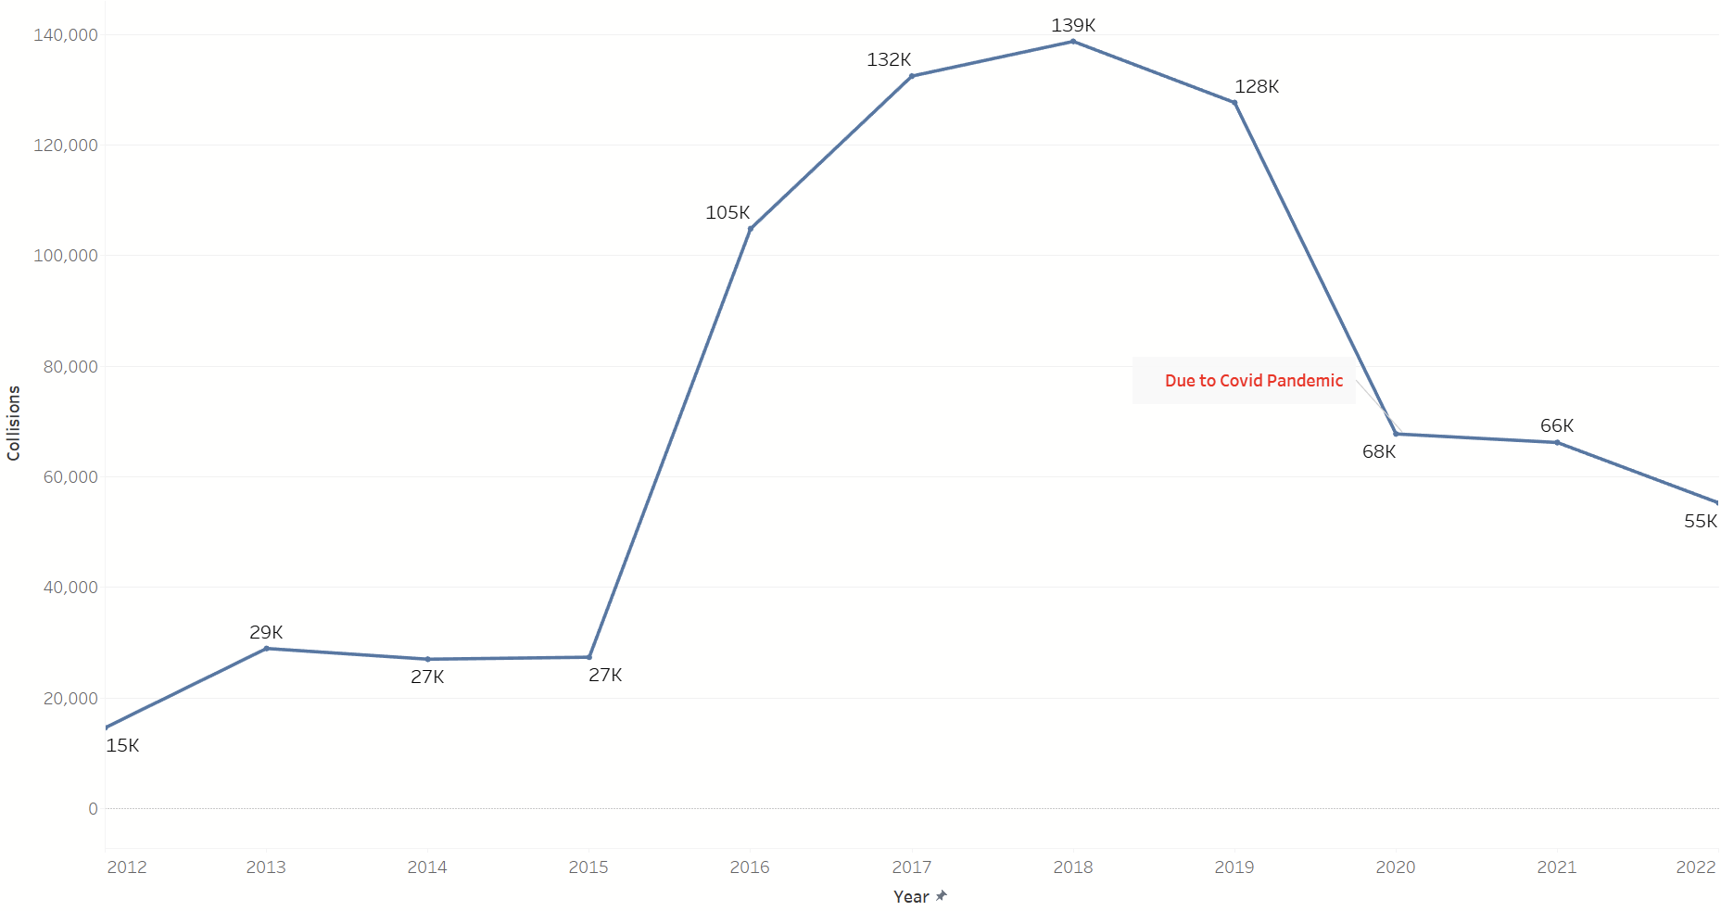
KPI: Number of Collisions by Year
Notes:
This line chart showing number of collisions by year allows us to see changes that occur over time. This allows us to investigate what year collisions are more likely to occur. We see here that collision counts peaked in the year 2018 with around 139,000 collisions across all of NYC.
Interestingly, the number of collisions began to decrease by around 11,000 before plummeting down to 68,000 when Covid hit. Today, the total number of collisions in the city is around 55,000.

Slide 3
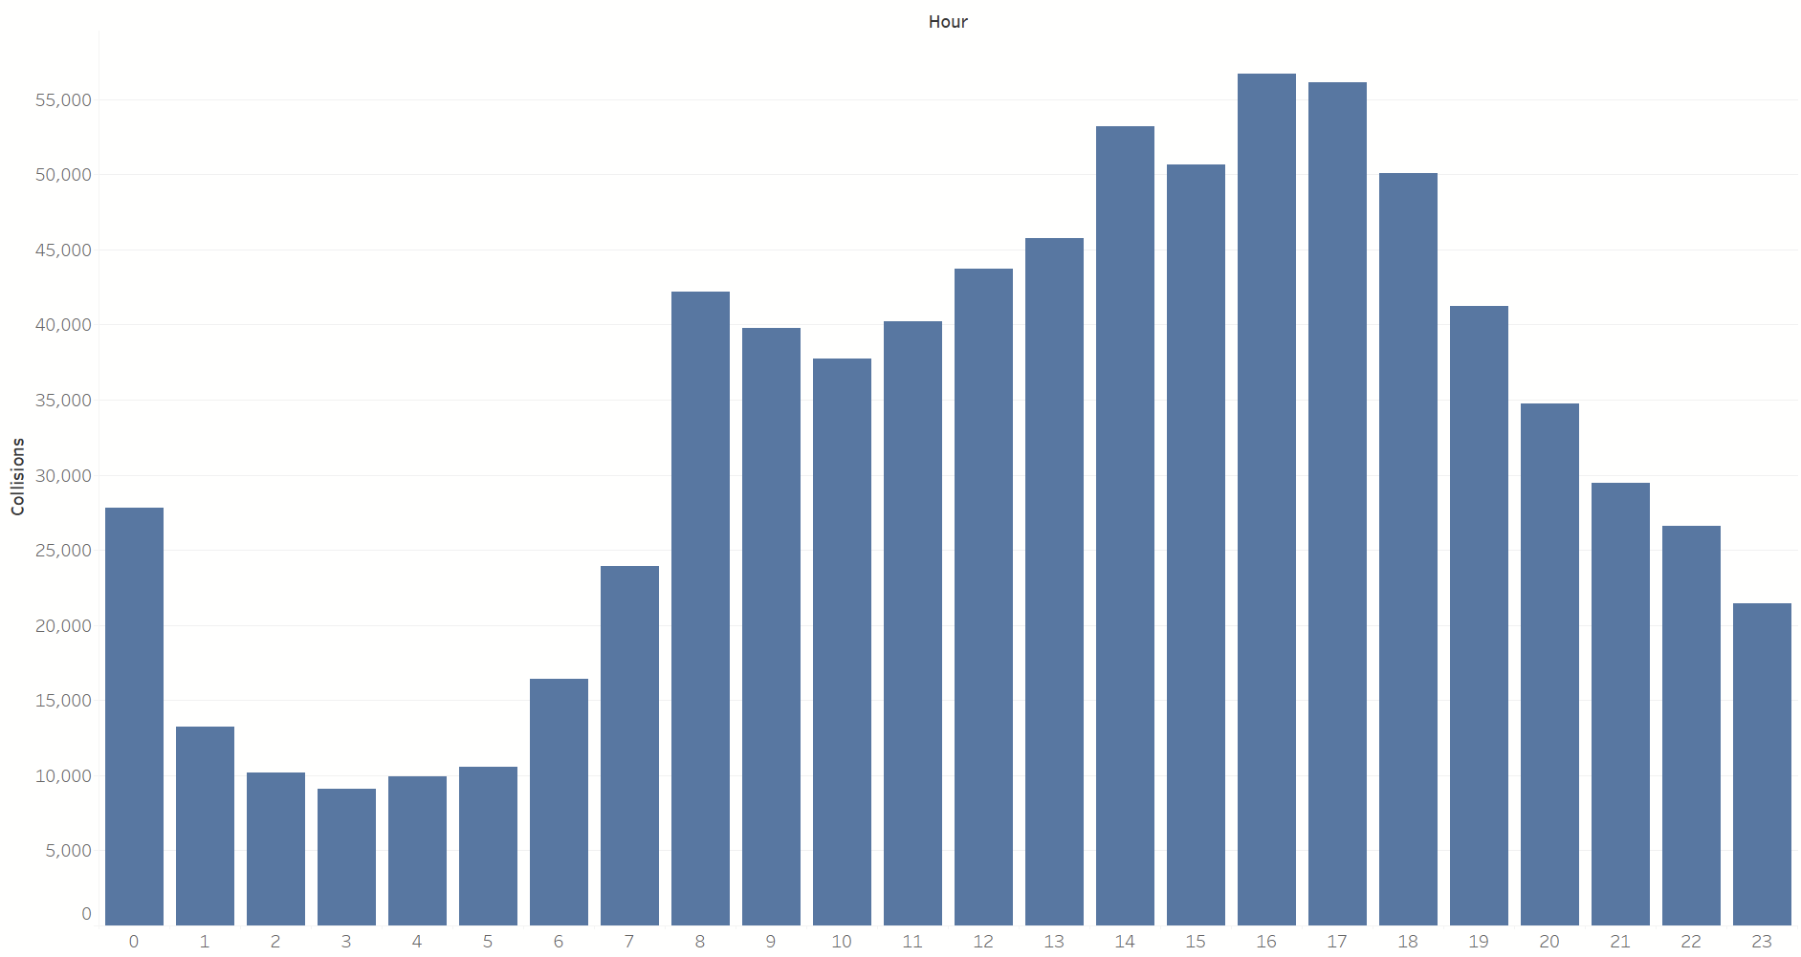
KPI: Number of Collisions by Hour
Notes:
This is a bar chart showing the number of collisions broken down by hour (using a 24-hour format). The MTA (Metropolitan Transportation Authority) or DOT (Department of Transportation) can use this insight to increase public transportation during crash- prone hours to disincentivize driving or implement congestion pricing during these specific hours (14:00-18:00 or 2pm-6pm).

Slide 4
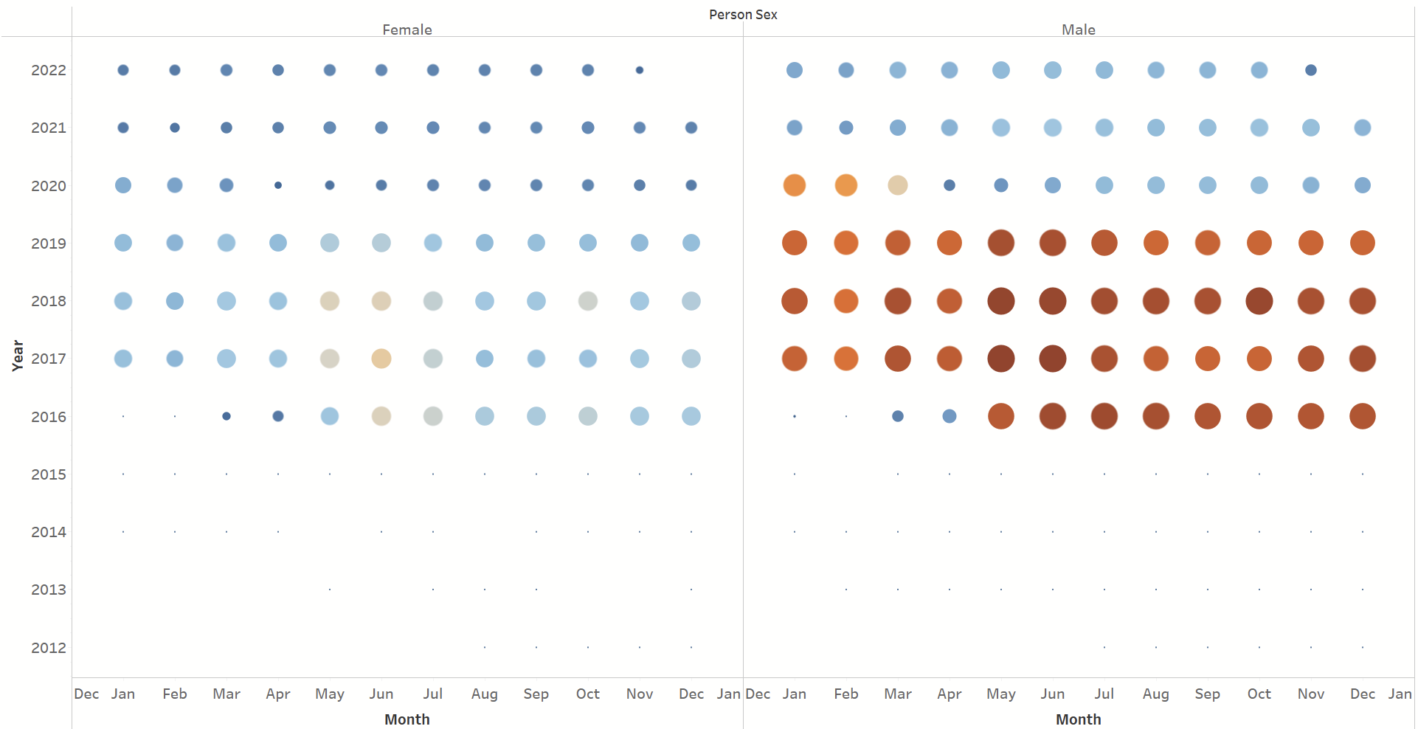

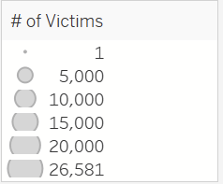
KPI: Number of Victims by Month
Notes:
Here we have a Bubble Graph showing the number of victims by month (by year). The size of each bubble correlates to the number of victims for that month. The double legend showing similar information might seem redundant at first but with the added color - you can visually pinpoint very quickly which months had higher victim counts. With the color removed and only leaving the size - it can be a little hard to differentiate which months had higher collision victims.
This can help the audience easily digest when most collisions take place and allow experts to better plan city traffic during months of high collisions.
We see that males are more likely to be involved in collisions - and the peak was the the year 2018 between the months of May through Dec.

Slide 5
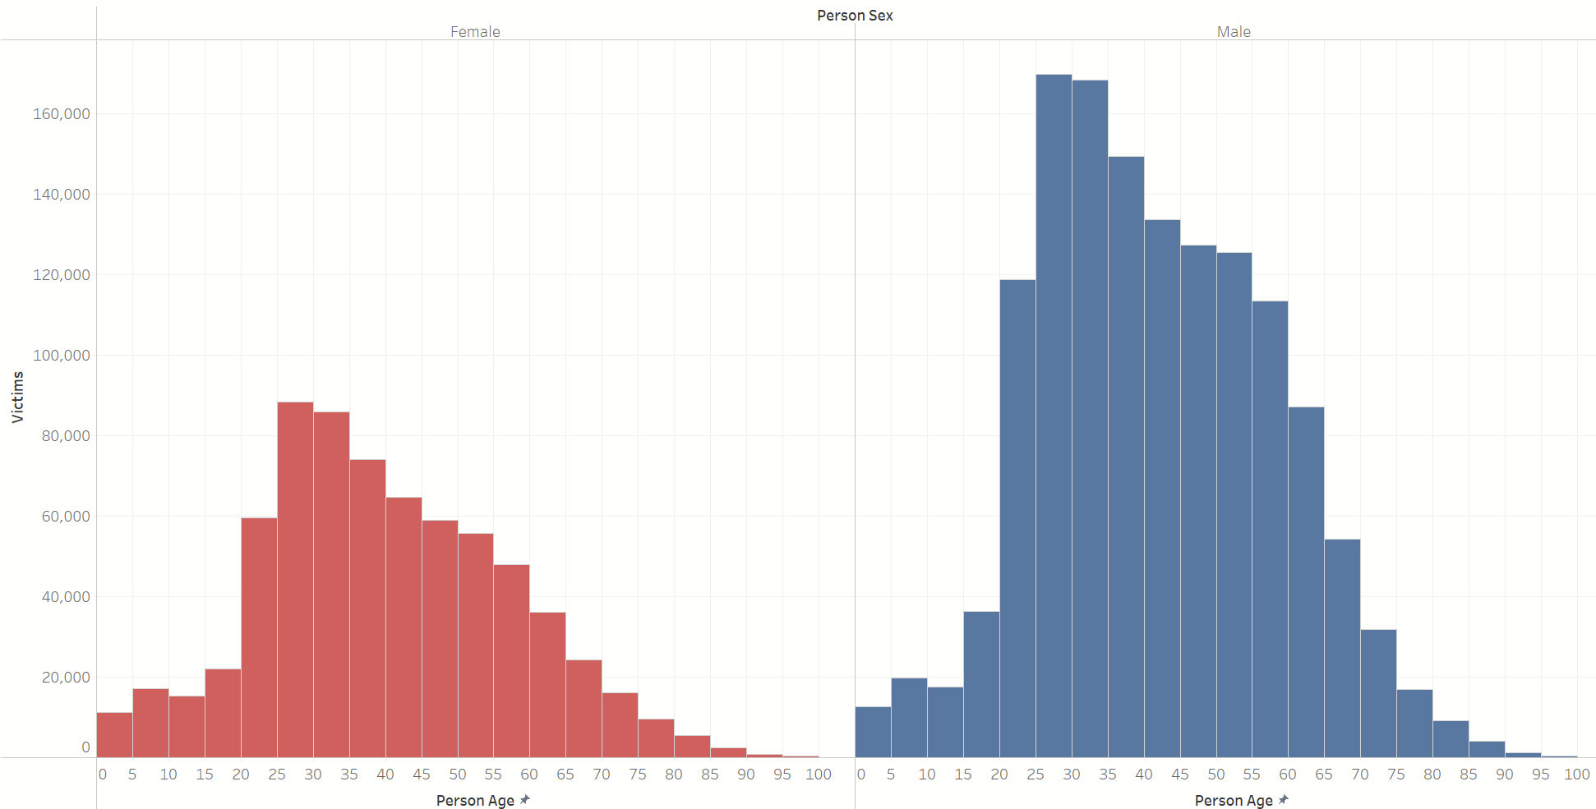
KPI: Number of Victims by Age
Notes:
Our fourth graph shows a histogram of the number of victims by age between female and male. Similar to what we’ve seen from the previous bubble graph - males are more likely to be involved in a collision with the peak victims being between ages 25-40 from both genders.

Slide 6
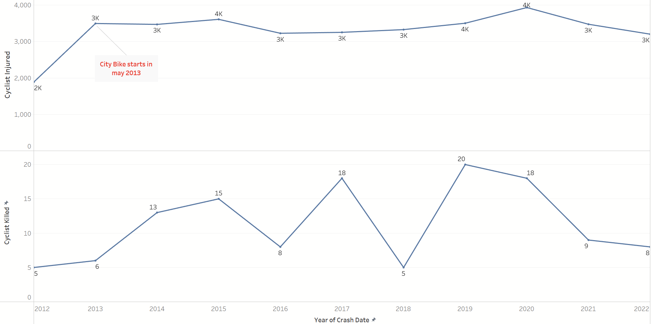
KPI: Number of Cyclist Collisions by Year
Notes:
Here we have another line graph to show changes over time in the number of cyclist collisions by year. We want to see how the introduction of city bikes since 2013 affected overall cyclist collisions (both injuries and death).

Slide 7
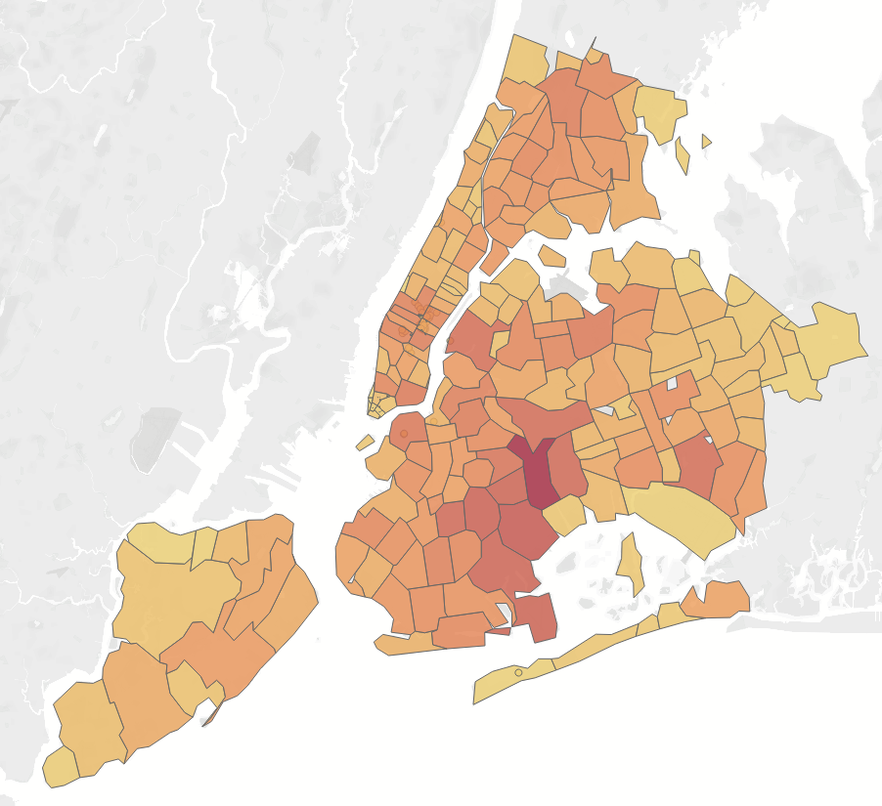
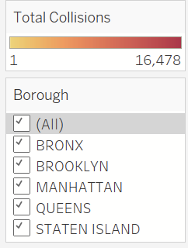
Number of Collisions by Zip Code - GeoMap
Notes:
Our last graph is a geomap of the number of collisions by zip code. Because our visuals are made in Tableau (and later published as dashboard), users can easily hover over the map to see the breakdown of collision counts by zip code.
We originally had a treemap graph here showing areas of high collision, but it pushed out and made smaller collision count zip codes harder to see since size of the treemap directly correlates to collision count.
The New York City Department of Transportation can prioritize zip codes with higher collisions to reduce and prevent collisions.

Slide 8
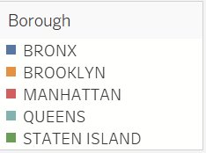
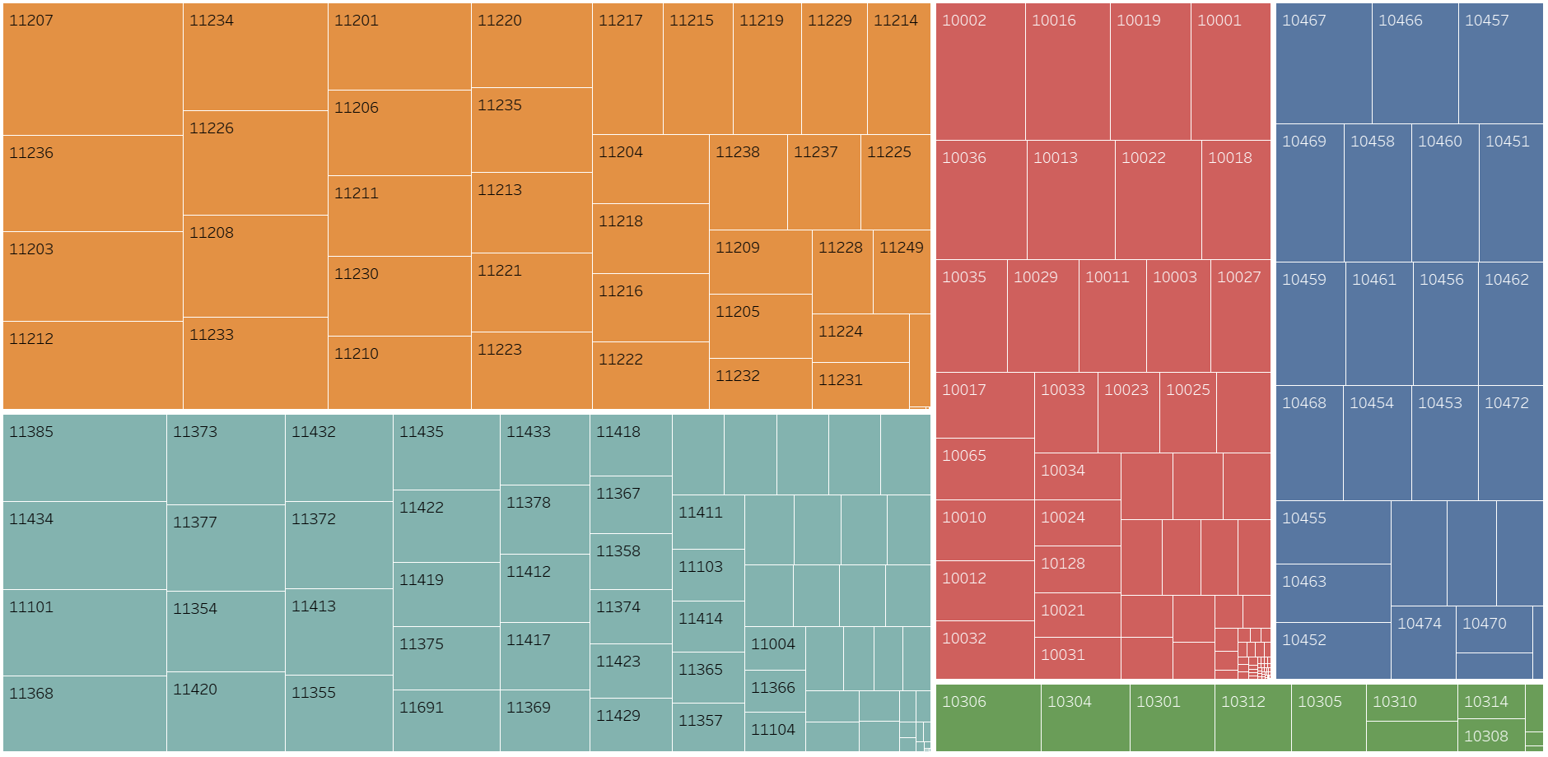
Number of Collisions by Zip Code - Treemap
Notes:
Our original graph for number of collisions by zip code was a treemap. This was helpful if we are only interested in the zip codes and boroughs with higher collision counts.
The New York City Department of Transportation can prioritize zip codes with higher collisions to reduce and prevent collisions.

Slide 9
Tableau Public Dashboards
Story:
https://public.tableau.com/app/profile/jason.jiang4864/viz/NYCMotorVehicleCollisionTransparency_Story/Story
Optional (ETL Jupyter Notebook):
Selected code chunks from our ETL

Slide 10
THANK YOU!

